Slide 1

-----------
LOAN STATUS PREDICTION
USING LENDING CLUB DATA

Slide 2

INTRODUCTION
Our purpose is to provide a case study which gives us an idea on how Lending Club business problems are solved
Using machine learning we will create a predictive analysis to get in-depth understanding of risk analytic strategies to determine if the borrower is worthy of receiving funding while reducing the risk of losing money

Slide 3

DATA
OVERVIEW
This dataset contains several features to determine
the weight of the borrower’s credit worthiness
Once those objectives are met Lending Club evaluates per borrower’s basis and provide one of the two following decisions:
*Loan Accepted
* Loan Rejected

Slide 4

01
CREDIT SCORES

Slide 5
01
02
DTI (DEBT TO INCOME)
CREDIT SCORES

Slide 6
01
02
03
DTI (DEBT TO INCOME)
CREDIT SCORES
EMPLOY-
MENT

Slide 7
01
02
03
04
DTI (DEBT TO INCOME)
PAYMENT HISTORY
CREDIT SCORES
EMPLOY-
MENT

Slide 8
01
02
03
04
05
DTI (DEBT TO INCOME)
PAYMENT HISTORY
CREDIT SCORES
EMPLOY-
MENT
INCOME

Slide 9
01
02
03
04
05
06
DTI (DEBT TO INCOME)
PAYMENT HISTORY
RISK SCORE
CREDIT SCORES
EMPLOY-
MENT
INCOME

Slide 10

LOAN DECISION ANAYLSIS
(GOOD LOAN V BAD LOAN)

Slide 11
Lending Club faces two types of risks:
If the borrower is likely repaying the loan, then not approving the loan results in a loss of business to the company.
01
02
If the borrower is likely NOT to repay the loan, i.e. they’re likely to default, then approving the loan will potentially lead to financial loss for the company.

Slide 12
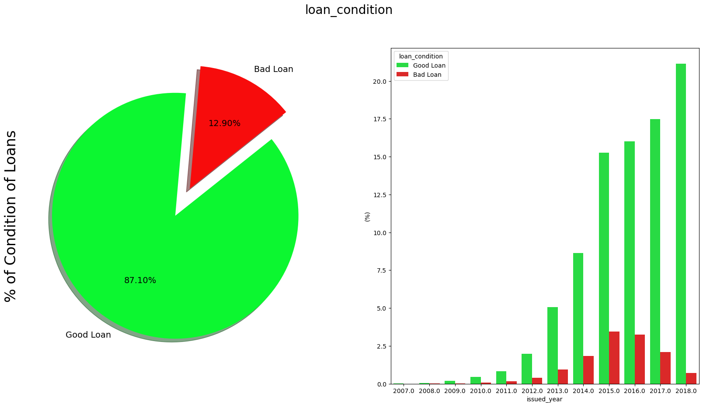
Good Loan v Bad Loan
Notes:
Breakdown of the loans based on the conditions of the loan status

Slide 13
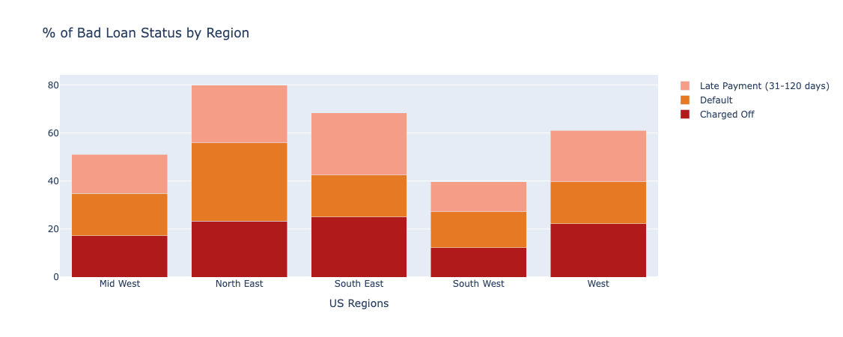
Notes:
Taking closer look into the bad loans by region determines the following:

Slide 14
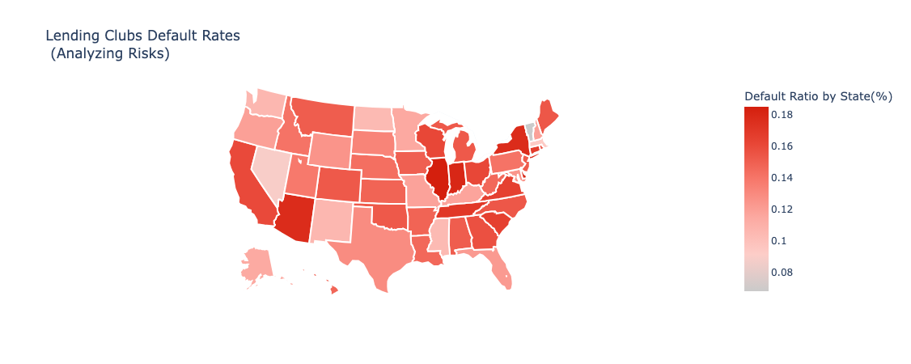
Notes:
In this third plot each state is calculated based on a Default Ratio ( bad_loan / and good_loan ).groupby(state).avg( )

Slide 15

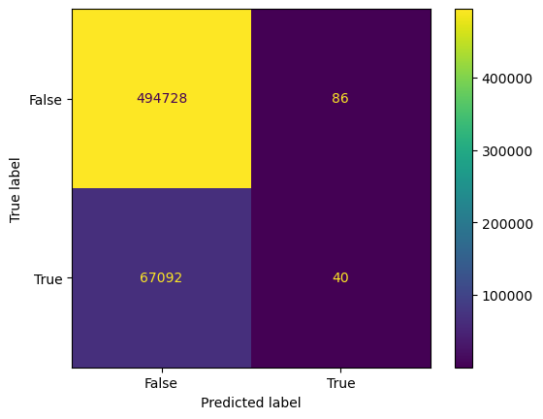
R-Score: 0.88
F1-Score: 0.94
Notes:
To test how accurate Lending Club makes their loan decisions, used logistic regression model

Slide 16

WEIGHTED AVERAGE ANALYSIS
The weighted analysis of feature importances reveals that several key factors significantly influence the prediction of loan defaults.
Issued Year: The year in which the loan was issued emerges as the most critical predictor.
Interest Rate: Higher interest rates are associated with increased default risk.
Debt-to-Income Ratio: A higher DTI suggests greater risk of default.
Annual Income: Lower annual incomes correlate with higher default probabilities.
Loan Installment: Larger installment sizes contribute to higher default rates.
FICO Credit Score: Lower credit scores are associated with increased default likelihood.
Loan Amount: Larger loan amounts also pose higher default risks.
Delinquencies: A history of delinquencies in the past two years, while still relevant, has a relatively lower impact on default predictions.

Slide 17
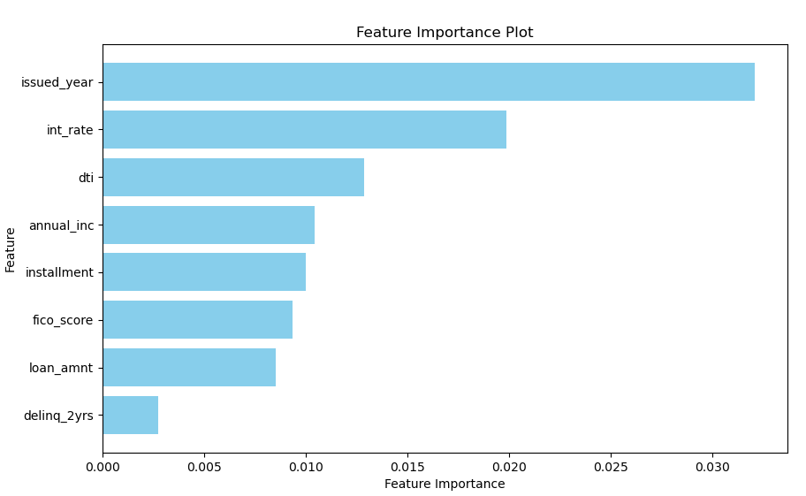
Here we see that the issued year to be the most significant factor in predicting a default. This is suggesting that newer loans are riskier, most likely due to the current state of our economy.
The second most significant factor we is interest rate. This is logical as higher interest rates would result in higher payments and be offered to lower credit score borrowers due to their credit history.

